Slide 1
INDIAN INSTITUE OF INFORMATION TECHNOLOGY, DHARWAD.

Slide 2
Topic : Music information retrieval system using opensource tools (MIRs).
Presented by:
Jagadeesh C (18bcs033)
Anuj C S (18bcs009)
Arun Kumar S M (18bcs013)
Darshan R P (18bcs023)
Project guide
Dr. Uma Sheshadri

Slide 3
overview
The main objective of this project is, it helps the user to identify name of the music/song or album just by listening to a small portion of that music.

Slide 4
Things used in this project
Python2.7 – is the programming language used in this project.
Python-pip – python package manager used to add or remove packages.
Python-tk – python library used to create GUI ( graphical user interface ).
ffmpeg – it is a command line tool designed to process audio and video files.
Portaudio – is a library used for audio playbacks and recording.
Pyaudio - provides Python bindings for PortAudio, With PyAudio, you can easily use Python to play and record audio on a variety of platforms.

Slide 5
Things used in this project
Matplotlib – is a python library used to data visualization and graphical plotting library for Python and its numerical extension NumPy.
Termcolor – it is a python module used for Color formatting for output in the terminal.
Scipy - Python library used for scientific computing and technical computing.
Pydub – it is a python library used to play, split, merge, and edit audio files.

Slide 6
How mirs works? (brief explanation).
MIRS identifies songs based on an “audio fingerprint”.
It uses a smartphone or computer's built-in microphone to gather a brief sample of audio being played.
MIRS stores a catalogue of audio fingerprints in a database.
The user tags a song for 10 seconds and the application creates an audio fingerprint.
MIRS works by analyzing the captured sound and seeking a match based on an acoustic fingerprint in a database of millions of songs.
If it finds a match, it sends information such as the artist, song title, and album back to the user.

Slide 7
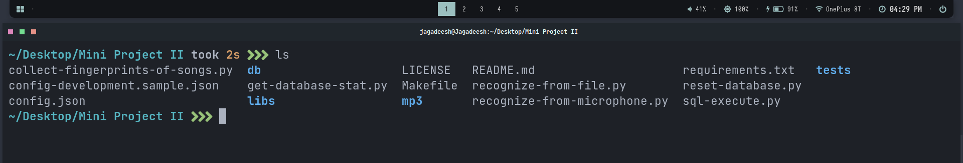
How it works
Music information retrieval system is a command line python application which returns the name of the song just by listening to a small portion of that song.

Slide 8
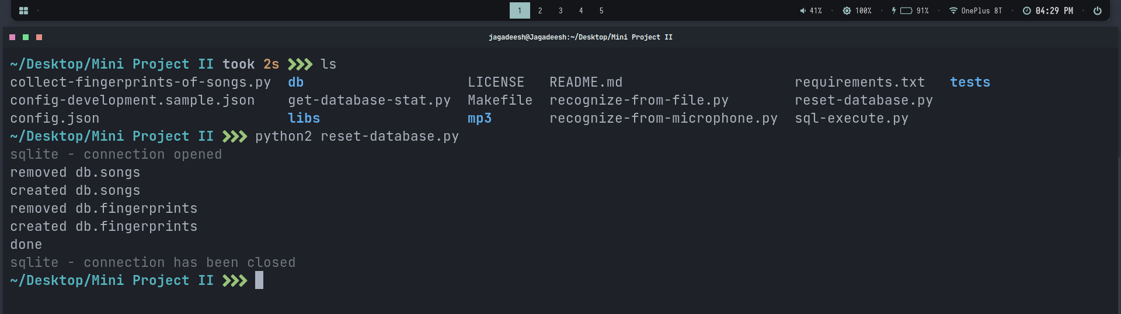
How it works
Python2 reset-database.py
Use to reset the database

Slide 9
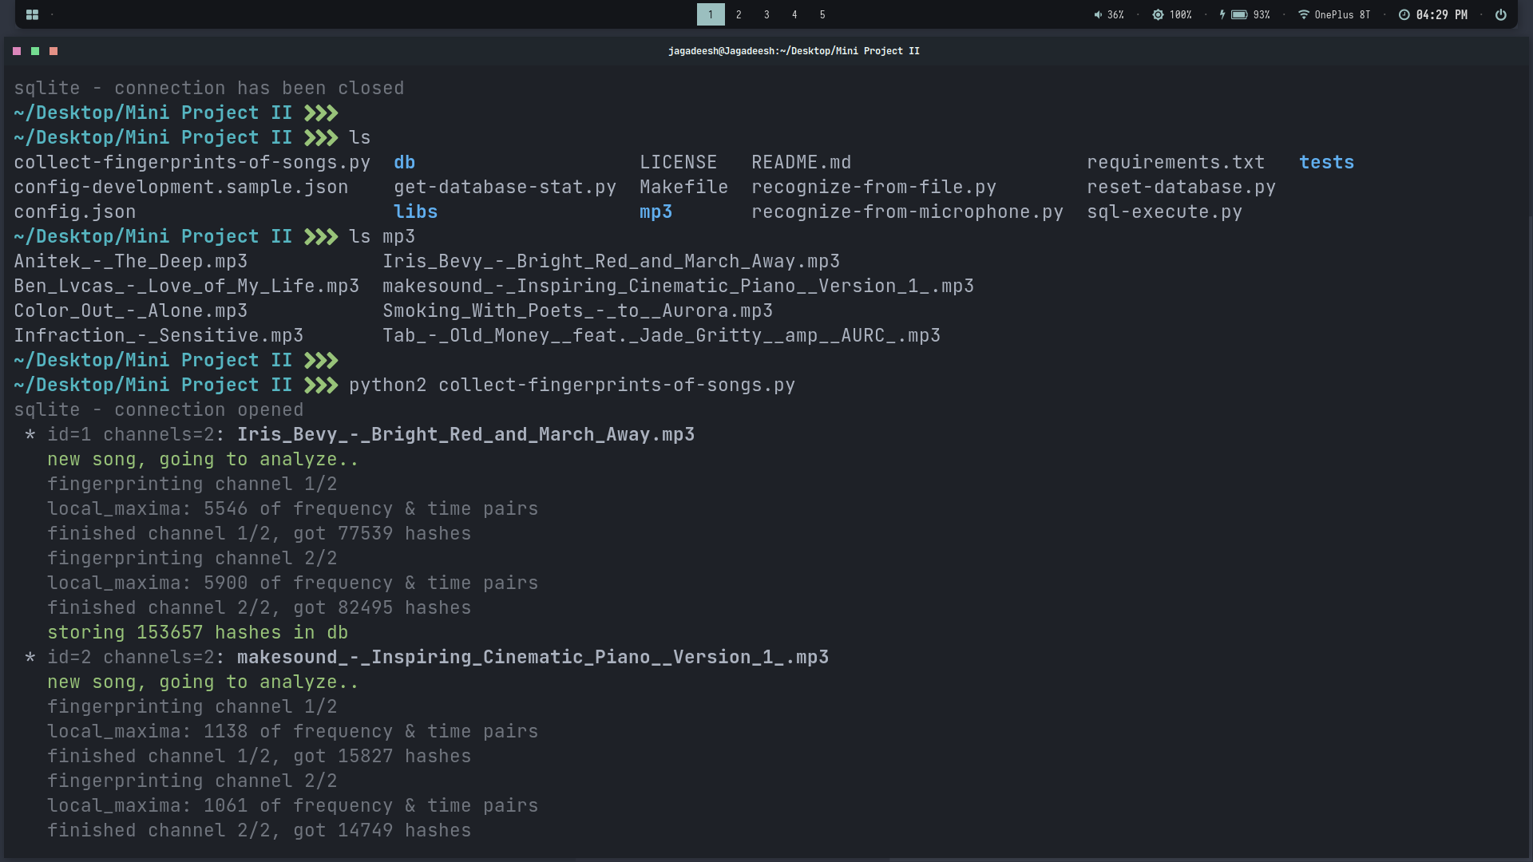
How it works
> python2 collect-fingerprints-of-songs.py
it is a python script used to create fingerprints of .mp3 songs stored in mp3 folder

Slide 10
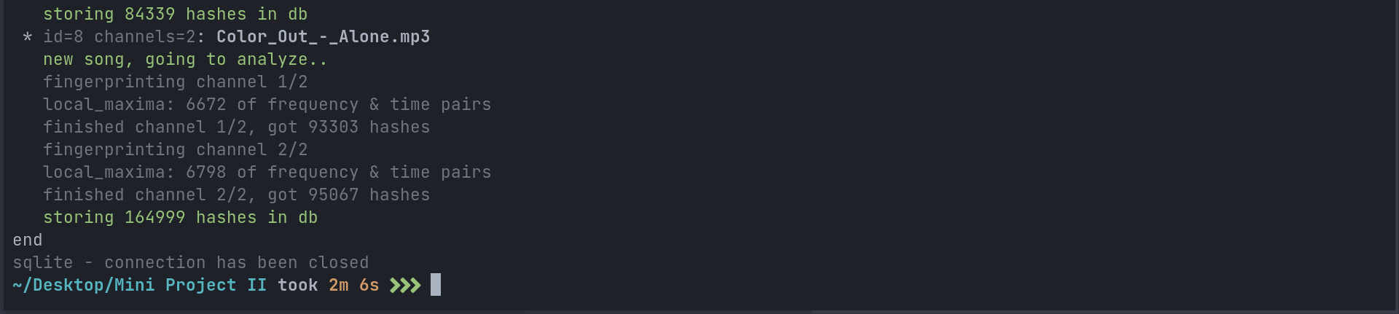

Slide 11
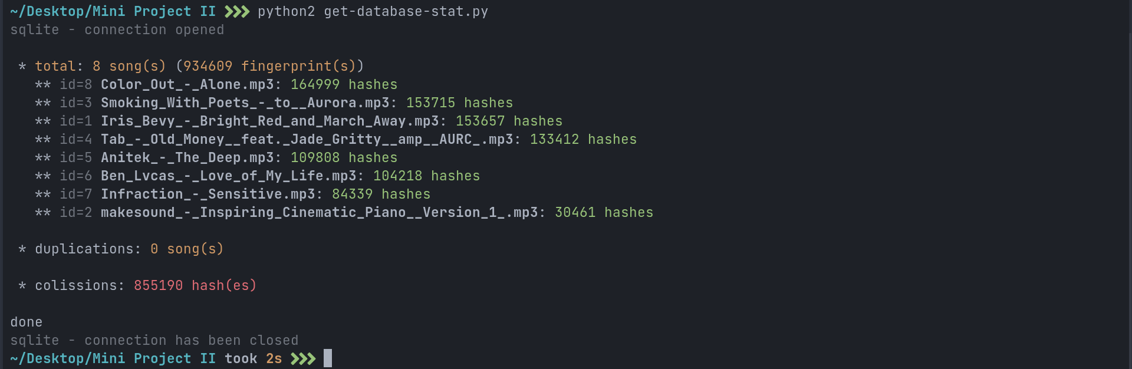
How it works
> python2 get-database-stat.py
it is a python script used to get the names/details of the songs whose fingerprint is created and stored in the database.

Slide 12
How it works
> python2 recognize-from-microphone.py –s n
It is a python script used to get audio input from microphone and returns the name of the song being played
Options
-s – defines how many seconds we want the script to listen
n – number of seconds
Example: python2 recognize-from-microphone.py –s 10
Will listen for 10 seconds

Slide 13
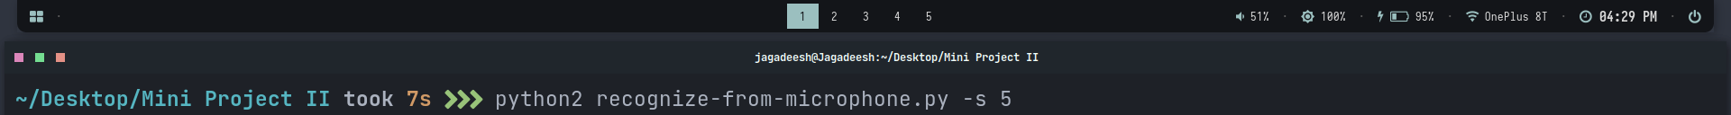
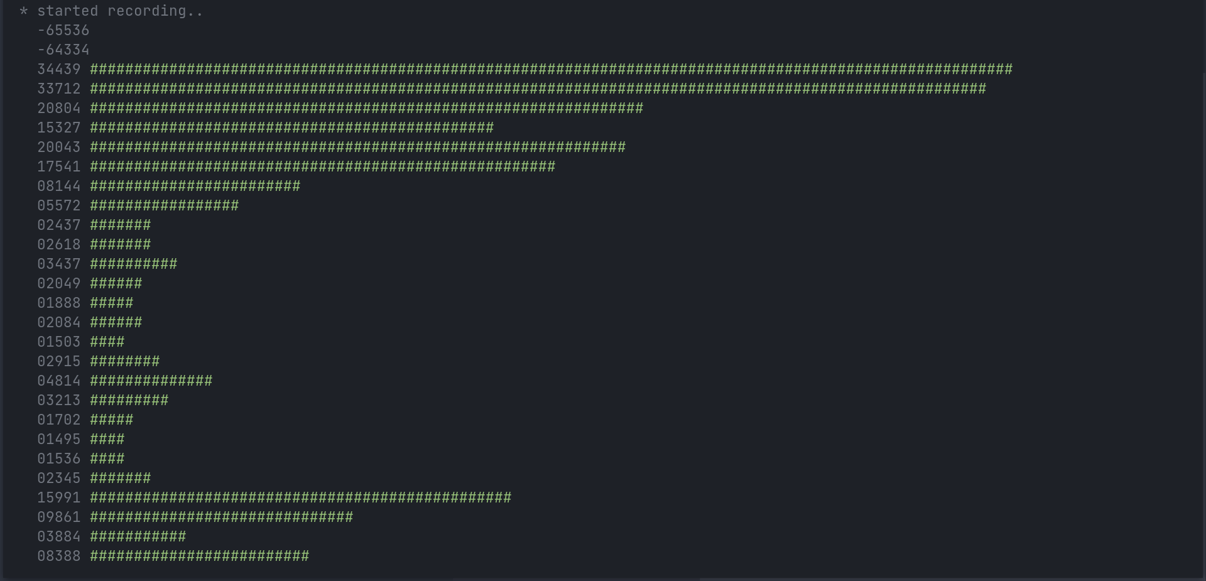

Slide 14
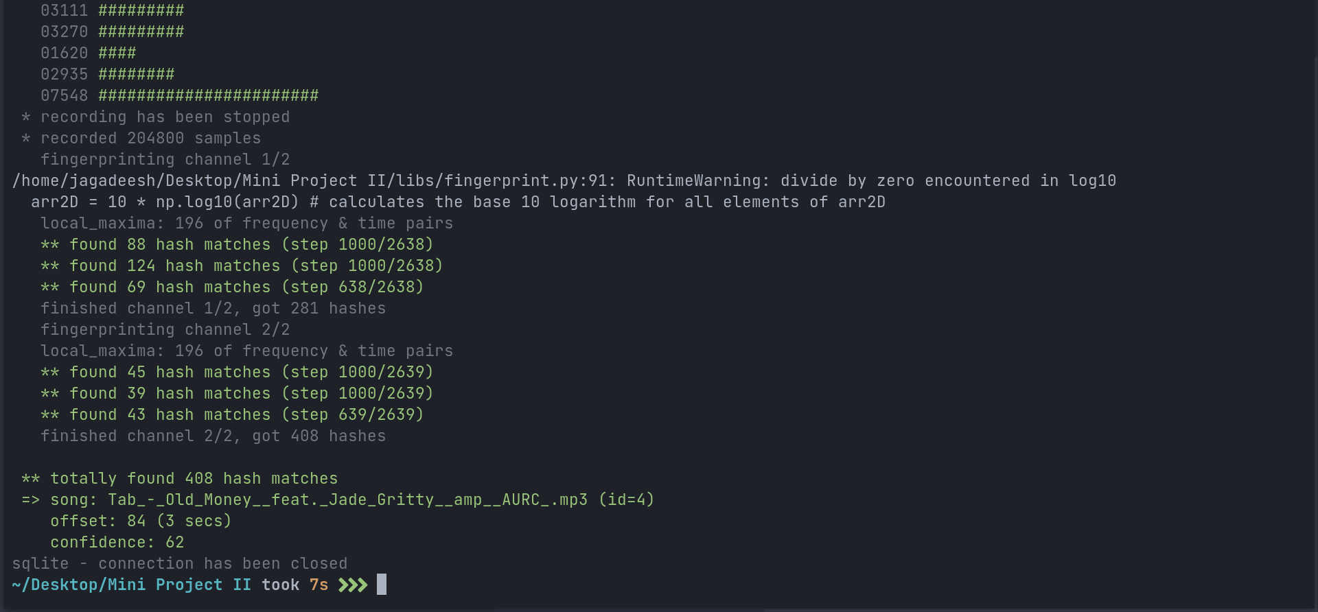
for the song Tab_old_money__feat.._Jade_Gritty__amp__AURC.mp3 being played it returned the name of that song.

Slide 15
Note:
An user only uses this application when he/she doesn’t know the name of a particular song/music, and our application helps them to find it.
Just for the demonstration,
We mentioned the name of the song in the beginning itself, so that we could verify the application detects the song correctly.

Slide 16
Previously developed mir apps
MIR is a small but growing field of research with many real-world applications.
There are several apps/applications developed on the idea of MIRS. like,
Shazam
SoundHound
Audiggle
Audio Tag
And many more..

Slide 17
Previously developed mir apps
Shazam
Shazam is an application that can identify music, movies, advertising, and television shows, based on a short sample played and using the microphone on the device.
It was created by London-based Shazam Entertainment, and has been owned by Apple Inc. since 2018.
Link: https://play.google.com/store/apps/details?id=com.shazam.android&hl=en_IN&gl=US

Slide 18
Previously developed mir apps
2. SoundHound
SoundHound Inc. is an audio and speech recognition company founded in 2005. It develops speech recognition, natural language understanding, sound recognition and search technologies.
Link: https://play.google.com/store/apps/details?id=com.melodis.midomiMusicIdentifier.freemium&hl=en_IN&gl=US

Slide 19
Open source algorithms
There are more than 198 open source algorithms are developed for MIRS. Like,
Essentia
C++ library for audio and music analysis, description and synthesis, including Python bindings.
http://essentia.upf.edu/
Musicinformationretrieval.com
Instructional notebooks on music information retrieval.
http://musicinformationretrieval.com/
Meyda
Audio feature extraction for JavaScript.
https://github.com/meyda/meyda

Slide 20
Open source algorithms
Madmom
Python audio and music signal processing library
https://madmom.readthedocs.io/
Strugatzki
Algorithms for matching audio file similarities
https://github.com/Sciss/Strugatzki
Audio-fingerprint-python project
Fingerprint audio files & identify what's playing
https://github.com/itspoma/audio-fingerprint-identifying-python
Links for more - https://awesomeopensource.com/projects/music-information-retrieval

Slide 21
Audio-fingerprint-python project
For our project we are using the “Audio-fingerprint-python” project
https://github.com/itspoma/audio-fingerprint-identifying-python
This project is shazam-similar app, that identifies song using audio fingerprinting.

Slide 22
References:
https://aclanthology.org/L16-1312.pdf
https://musicinformationretrieval.com/index.html
https://github.com/itspoma/audio-fingerprint-identifying-python
Jagadeesh C(18bcs033)
Anuj C S(18bcs009)
Arun S M (18bcs013)
Darshan R P(18bcs023)

Slide 23
THANK YOU

